Slide 1
IEA-Retired Celebrating 35 Years of Working for Our Members
1990-2025

Slide 2
A Timeline of the Creation of IEA –Retired
1985 NEA by-laws amended to integrate retired members & require unified membership.
1989 IEA RA NBI approved authorizing the forming of a committee for developing an IEA-retired Program.
Retired Membership Committee members were: Dennis Koutouzos, Chair, Carol Bland, Staff, Anne Davis, Virginia Gosse, retiree, Keith Hauge, Retiree, Molly Phalen
This group recommended the following NBI in 1990, which passed.
1990 IEA RA NBI approved to create IEA-Retired and to begin actively organizing IEA-Retired members beginning with those who retire in 1990.

Slide 3
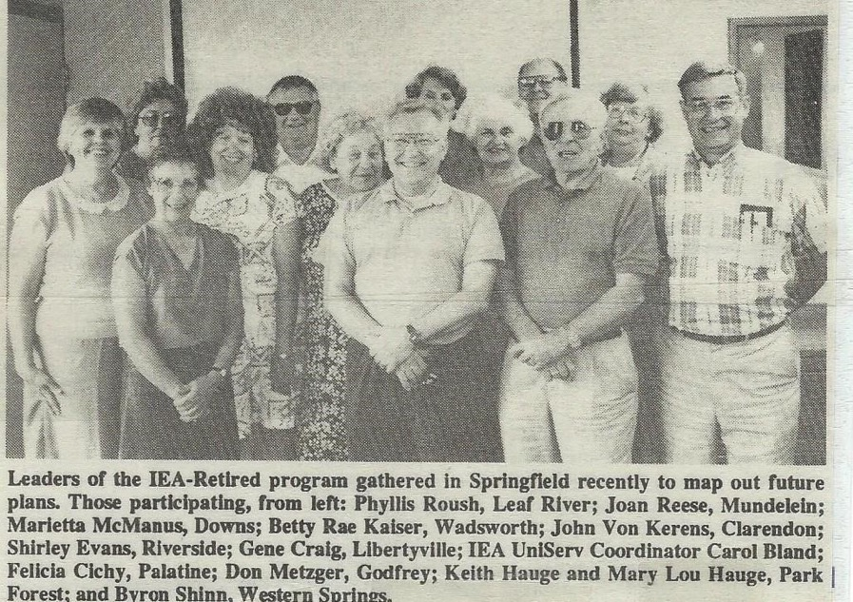
Retired Implementers Developed a Set of Goals for the IEA-Retired Program in 1990
The Implementers were Felicity Cichy, Shirley Evans, Samuel Franklin, Ivo Grief, Jay Hammer, Keith Hauge, Mary Lou Hauge, John Von Kerens, Margaret Leyda, Don Metzger, Nancy Miller, Tom Prather, Marilyn Rich, Phyllis Rousch, Vince Wilhelmi

Slide 4
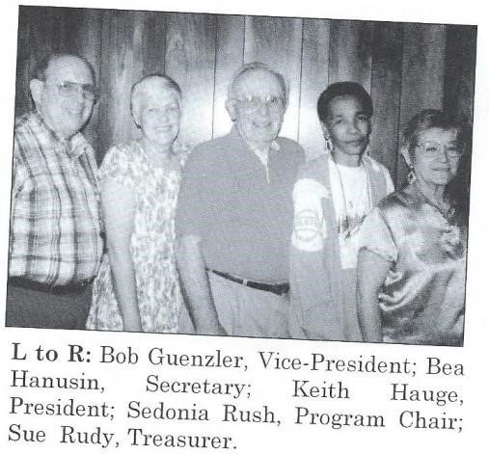
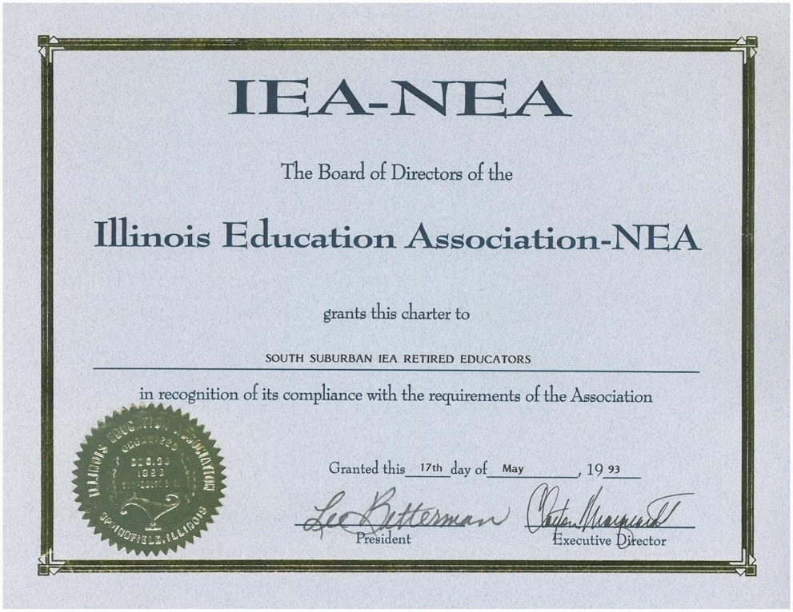
First chapter: South Suburban
1991 IEA RA by-law approved defining retired dues options.
1992 IEA RA by-law approved establishing pre-retired enrollment option.
1993 IEA RA by-law
approved authorizing retired chapters.
.
.

Slide 5
IEA-Retired Membership
Currently there are 22 retired chapters in Illinois and 2 in Florida.
Maintain your IEA/NEA membership by joining IEA-Retired and a retired chapter to
Keep informed about issues effecting pensions, health insurance benefits, and educational issues.
Keep $1 million liability insurance for members who take temporary work in public school systems.
Continue access to NEA Member Benefit programs that provide cost savings in insurance, travel, credit card and discount purchase programs.
Attend state and national conferences
Participate in legislative events and Lobby Days.
Maintain contact with fellow retirees by joining a local chapter, affiliated with each regional IEA office
Participate in retired chapter programs on topics of interest such as TRS, identity theft, investment planning, travel, and adult education.
Participate in interesting and informative field trips to local restaurants, museums, theaters, parks and points of interest.

Slide 6
In1994 an IEA-Retired Task Force was appointed. This resulted in many by-law changes at the 1995 and 1996 IEA RAs
A 1994 IEA RA by-law approved authorizing the formation of an elected Council of Retirees with the Chairperson of the Council becoming a voting member of the IEA Board of Directors
Members of the 1994 IEA-Retired Task Force Mary Lou Hauge – retired Clay Marquardt – staff Barb Gilhaus – retired Carol Bland – staff
Ray Price Betty Thielemann – staff
Jack Stone
Rob Johan
Dottie Beeler
Linda Davis

Slide 7
Retirees Bring Forward By-Law Amendments at IEA-RAs
Delegates at various RAs
Adopted establishing unified NEA-Retired and IEA-Retired dues
Adopted adding a retired Ethnic Minority delegate to the IEA RA.
Adopted a new line item to the budget funding a full-time para-professional staff position for IEA-Retired
Adopted requiring retired chapter membership along with IEA/NEA-Retired membership to be eligible for election to the Council of Retirees, Chair and Vice Chair, and as an RA delegate.
Adopted adding an Education Support Professional rep to the Retired Council
Adopted changing the name of The Haisman New Teacher award to The Haisman Early Career Award.

Slide 8
Retirees Bring Forward Amendments to the IEA Legislative Platform
Delegates to various RAs
Approved amending IEA Resolutions to include LGBTQ+ to the section on Access to Published Materials
Approved IEA supports: teaching curricula based on facts, scientific data, and equity.
Approved IEA opposes: censoring access to printed materials and online resources related to multiculturalism and all aspects of racism.
Approved IEA opposes: the banning/burning of reading materials
A member of IEA-Retired submitted a legislative program amendment to NEA to support Anyone living on Native Land and eligible to vote, must be allowed to both register to vote and to have full voting rights in all elections. This concept was added to the NEA Legislative Program
Approved IEA Supports Assuring affordable and appropriate benefits for prescription drugs, quality and accessible elder care, home health care, caregiver supports, and mental health services, nonmedical aid and medical transportation services across and in all geographic locations.

Slide 9
Retirees Take Action

Slide 10
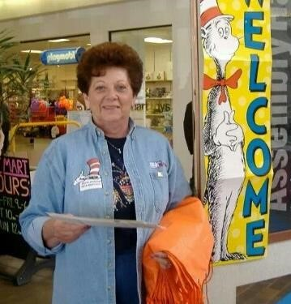
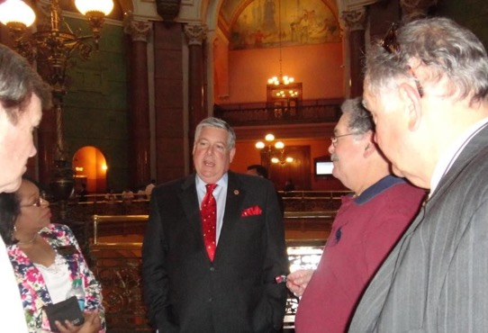
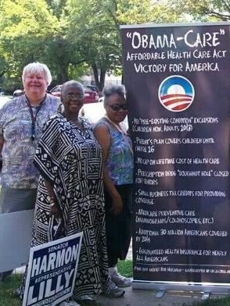
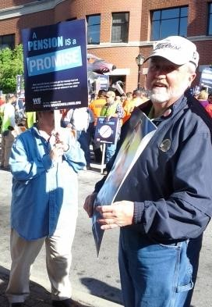
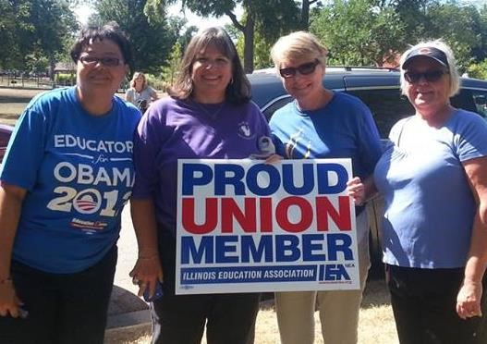

Slide 11
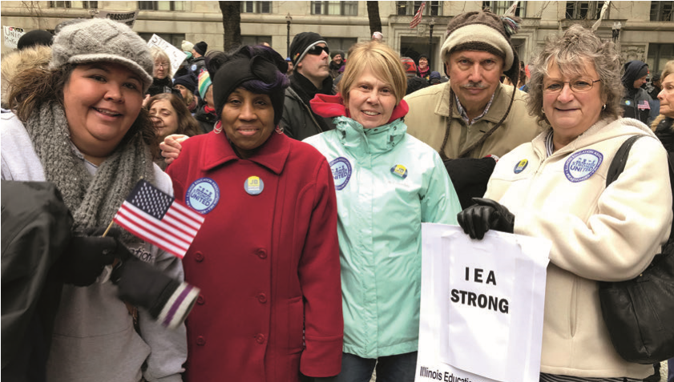
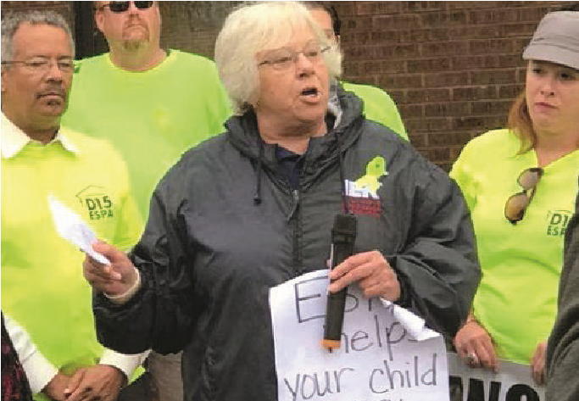
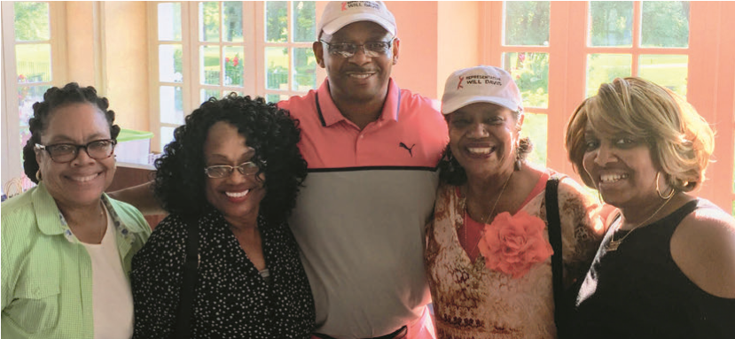
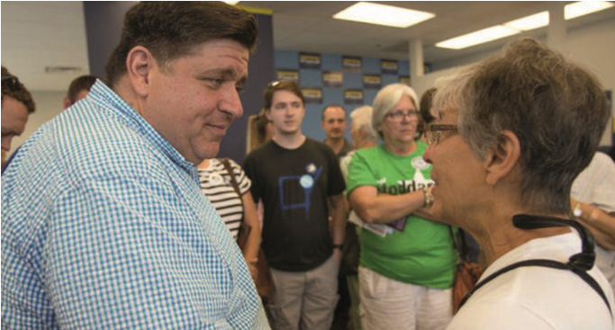
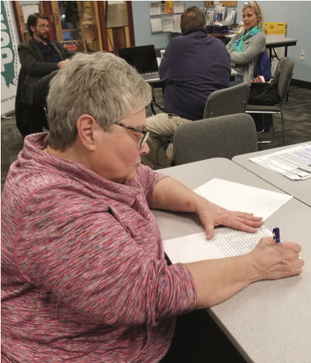
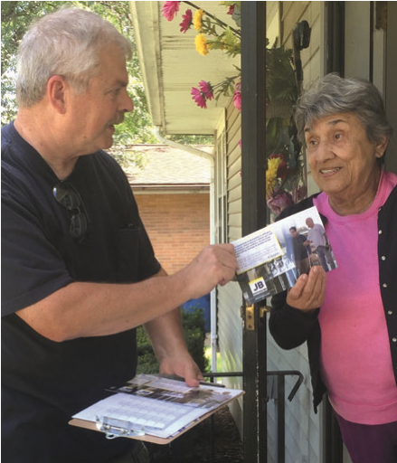
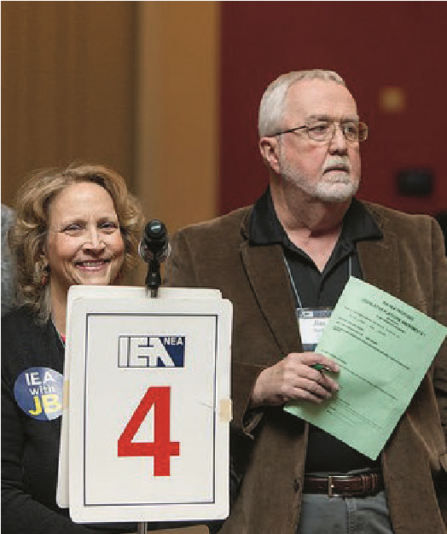
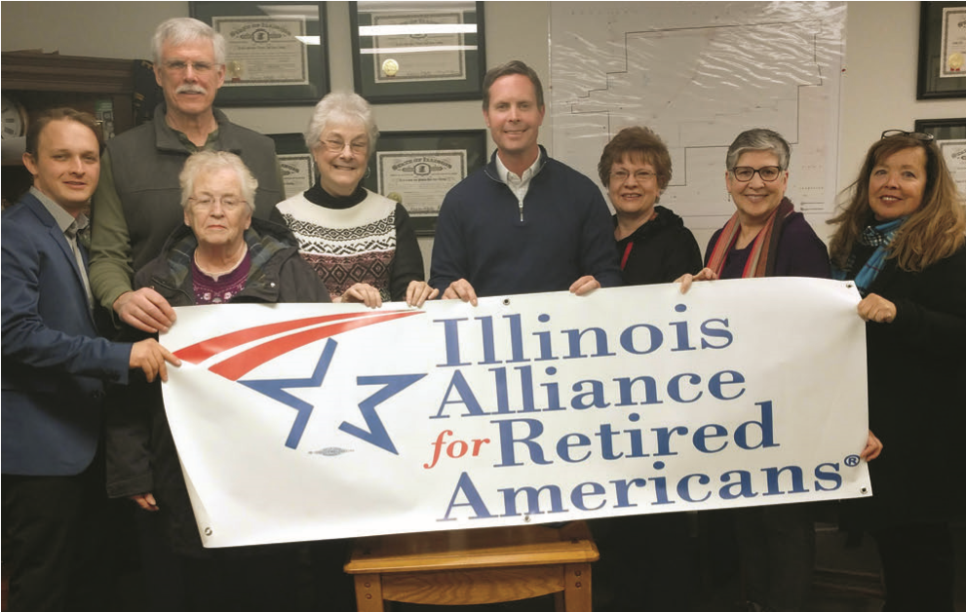
RETIREES STAND UP!
SPEAK OUT!
ACT AS ADVOC ATES!

Slide 12
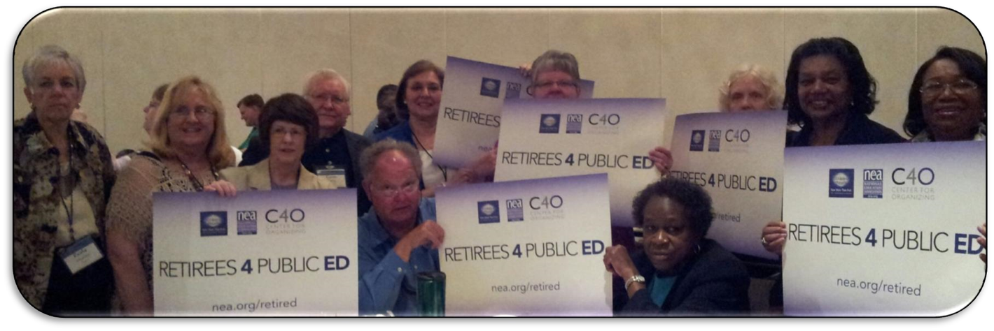
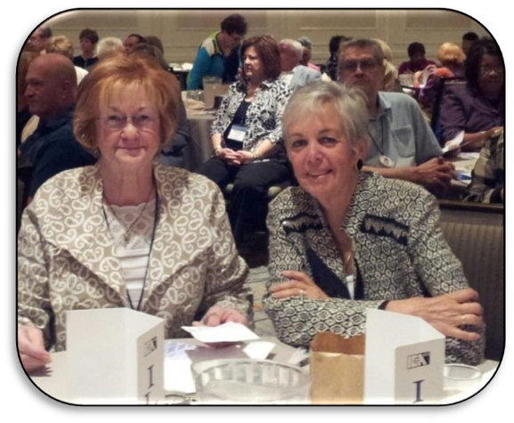
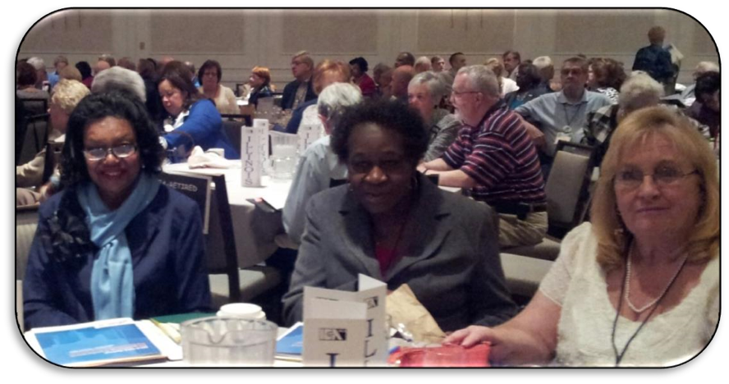

Slide 13
Mary Lou Hauge Award Established in 1994 and Renamed the Mary Lou and Keith Hauge Award in May 2005
This award was conceived by Barb Gilhaus and established by the IEA-Retired Council in 1994.
Its purpose is to recognize those IEA-Retired members who have made significant contributions to the IEA- Retired program.
As with many school employees, Mary Lou and Keith’s retirement did not decrease their desire or passion to help students have the best educational opportunities that could be provided.
They also believed that it was necessary for retirees to monitor and enhance their pension and health insurance benefits and thought that the best method for a retired school employee to achieve these goals was for retired IEA members to continue their IEA involvement.
To begin to achieve this goal, Mary Lou and Keith traveled throughout Illinois organizing Chapters of IEA-Retired members. They continued the work of IEA-Retired throughout the rest of their lives.
Since 1994 twenty nine (29) retired members have received this award.

Slide 14
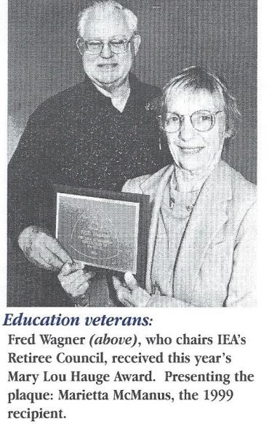
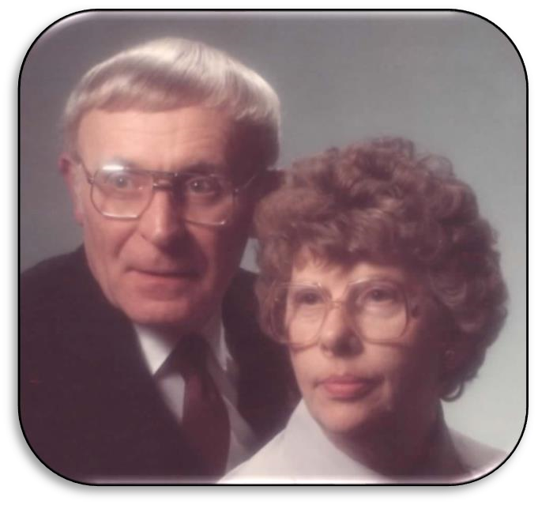

Slide 15
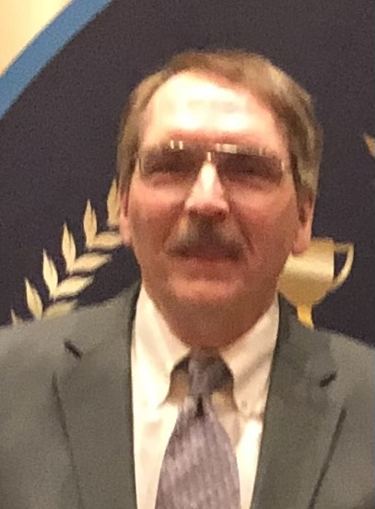
The IEA-Retired Mentor Program was created in 1999.
The Mentor Program works with the IEA Aspiring Educator Program to mentor students on many campuses across the state of Illinois. Much of the mentoring is done via email, text, and phone due to the large area of our state. A mentor allows for a non-evaluative, experienced educator to talk, share, and encourage an education student. It gives the college student a safe place to vent frustrations, bounce off ideas, and ask for advice.
2019-Present Tim Brinker

Slide 16
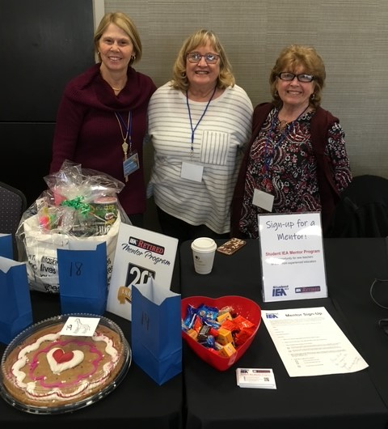
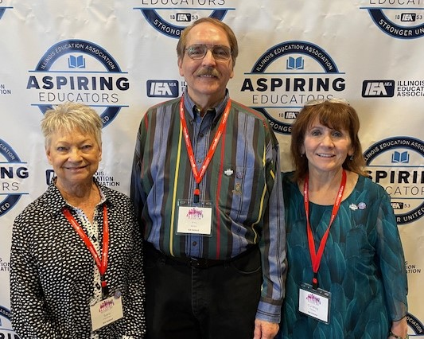
Being an IEA-Retired
Mentor is Joyful

Slide 17
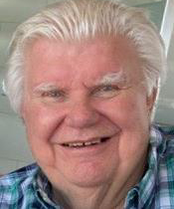
Haisman Awards Created in 1999
The Haisman awards were created to honor the retiring IEA President, Bob Haisman. They were created to honor an early career educator with less than 5 years of teaching experience and to honor a student in the IEA Aspiring Educator Program.

Slide 18
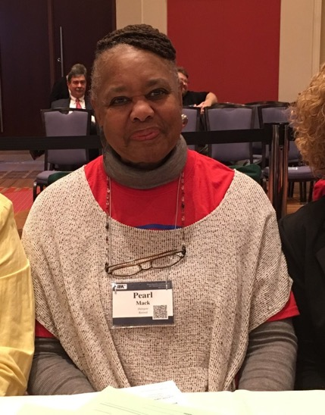
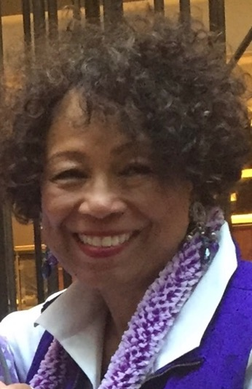
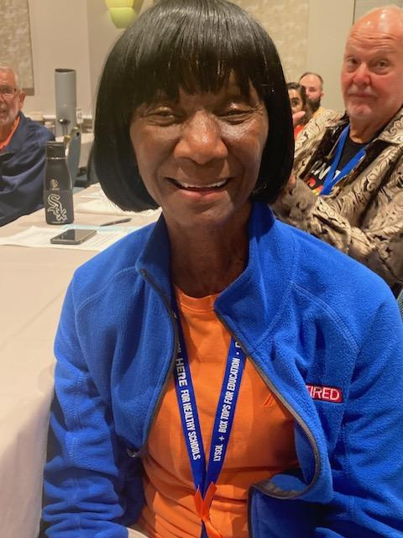
2011: An IEA RA by-law Amendment Added a retired Ethnic Minority Delegate to the IEA RA
Pearl Mack 2012 & 2019
JoAnn Kenner 2014 & 2015
Loretta Tisdel
Dottie Beeler 2013

Slide 19
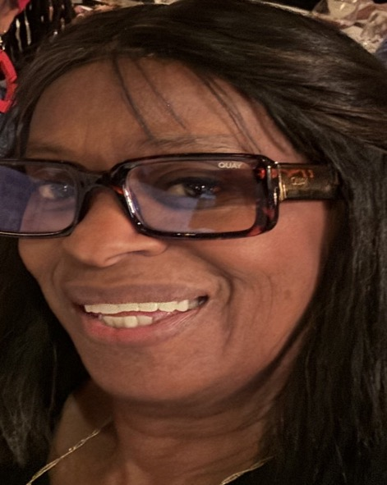
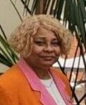
Ethnic Minority Delegates to the IEA RA
Mary Ann Rivera
Diane Randolph 2018 & 2021
Ina Allen 2020

Slide 20
IEA Retirees Elected to Positions on NEA Retired
2002 Gene Craig was the 1st IEA-retired member elected to the NEA-Retired Advisory Council.
2006 Gene Craig was elected Secretary/Treasurer of the NEA-retired Advisory Council and served 2 three-year terms.
2009 Mae Smith was elected to the NEA-Retired Executive Council
2018 Ross Dill represented retirees across the nation on the NEA Resolutions Committee.
Mae Smith was elected to the NEA Board of Directors as a retired representative.
Gene Craig received the NEA-Retired Distinguished Service Award.
Janet Kilgus elected alternate NEA Director for NEA Retired.
2022 Ross Dill to the NEA -Retired Executive Council.
2024 Ilene Siegel was elected to the NEA Retired Resolutions Committee

Slide 21
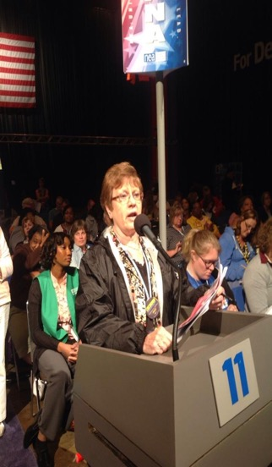
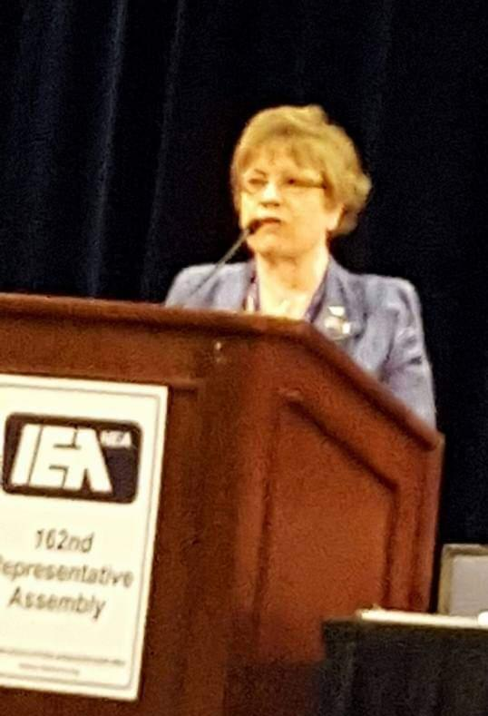
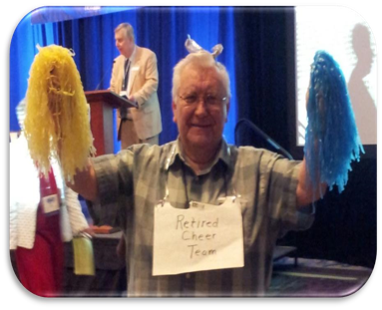
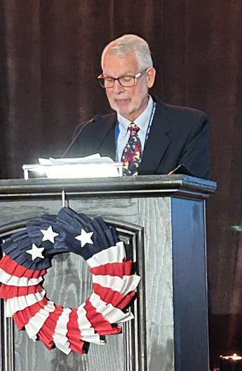
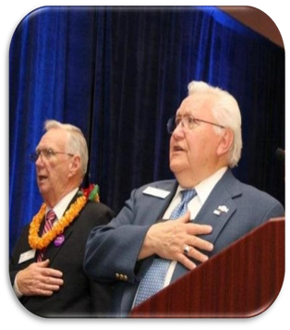
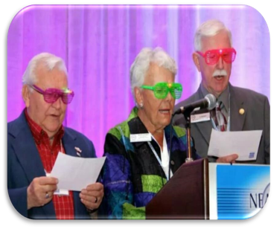
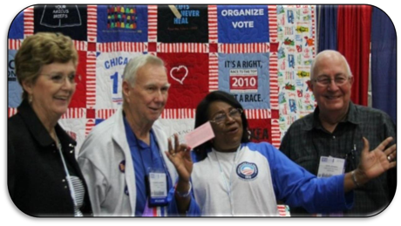
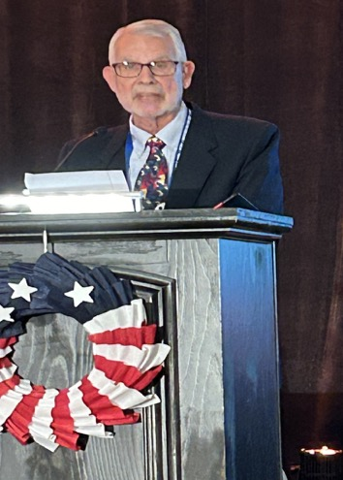
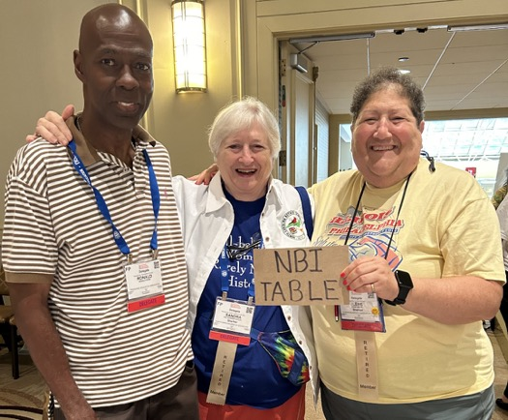
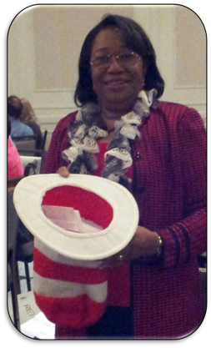
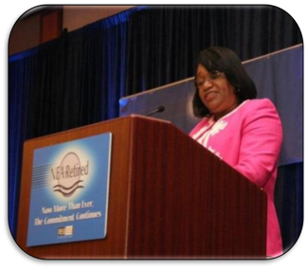
Gene Craig
Ross Dill
Janet Kilgus
Mae Smith
Ilene Siegel

Slide 22
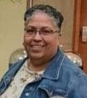
2018: IEA By law Amendment added an Education Support Professional Representative to the Retired Council
Sandy Drafall 2019-2023
Mary Ann Rivera 2023-Present

Slide 23
2018: Ethnic Minority Representative Added to The Council of Retirees
Loretta Tisdel 2019-2024
Ina Allen 2024-

Slide 24
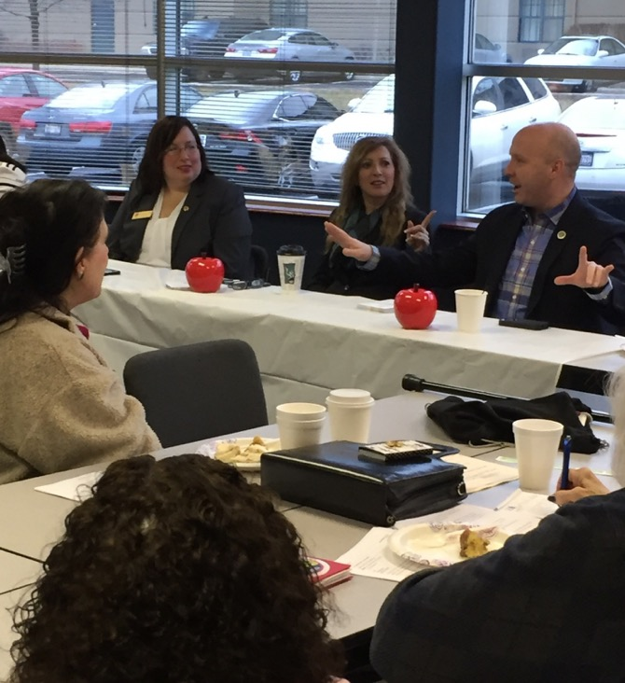
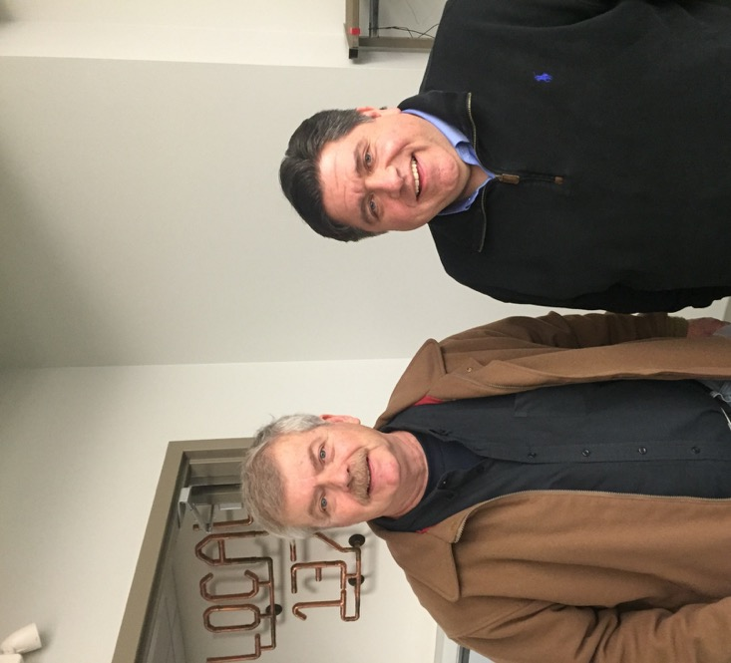
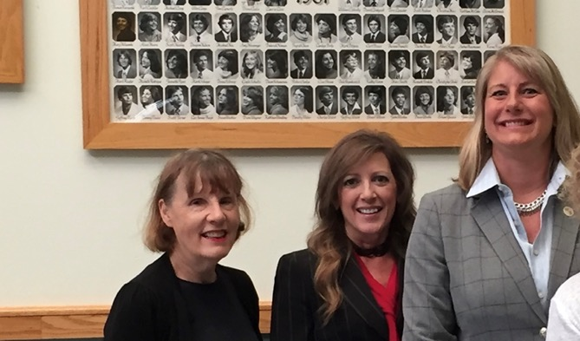
Retirees Meet with Legislators

Slide 25
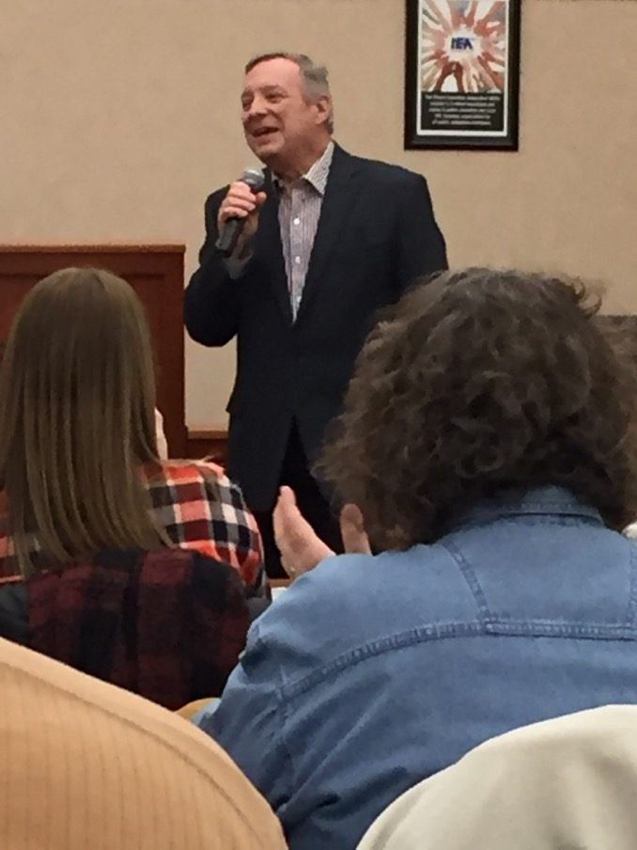
Meeting with Legislators

Slide 26
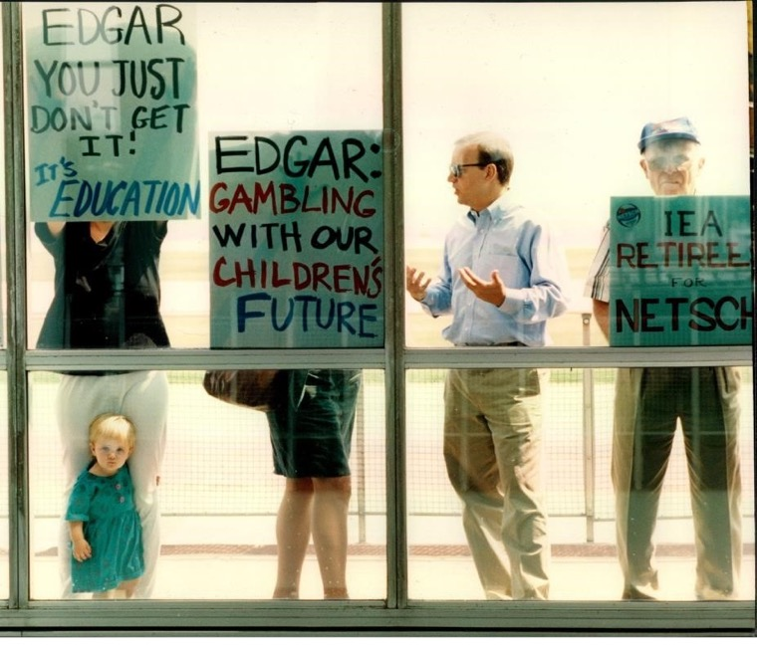
Retirees Advocate for Issues Impacting Public Education and Our Union
•
•

Slide 27
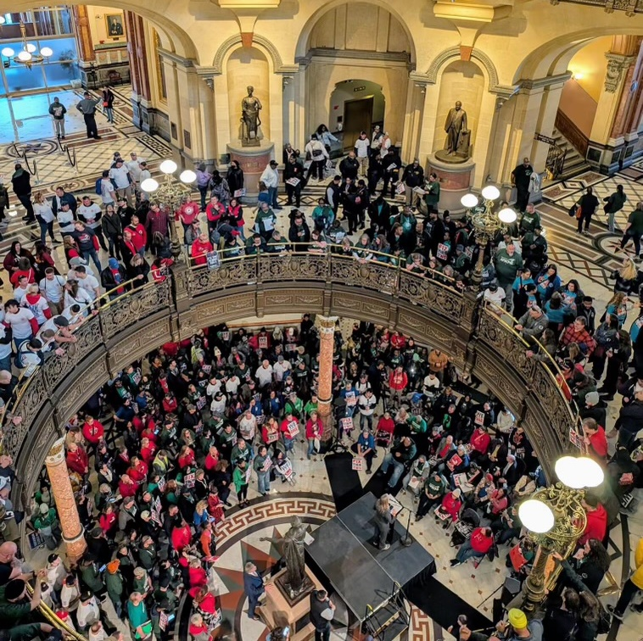
Retirees Lobby to Undo Tier 2

Slide 28
The Council of Retirees Created Retired Committees
From the 1990’s to the present the Council has created committees to meet the needs of retired members.
Budget Committee
Communications Committee
Conference Committee
Health and Wellness Committee
Legislative Action Committee
Membership Committee
Racial and Social Justice Committee

Slide 29
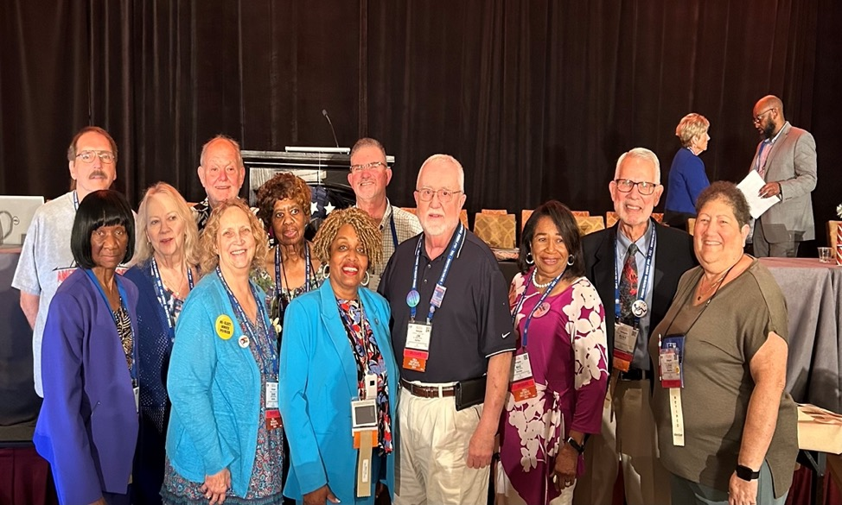
Retirees Attend Conferences

Slide 30
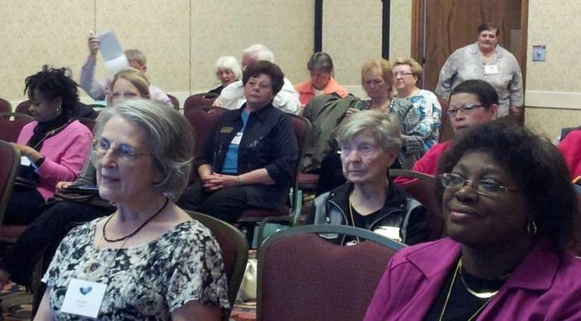
IEA-Retired participates in conferences: Summer leadership academy, the One Conference, NEA Retired winter and summer conferences, the student conference, IEA and NEA Representative Assemblies.

Slide 31
2024-2025 Council of Retirees

Slide 32
Council of Retirees Chairs
Jim Duffy
2019-2024
Mary Lou Hauge
1994-1996
Jack Tucker
2006-2011
Fred Wagner
1997-2005
Janet Kilgus
2012-2018
Loretta Tisdel
2024-Present

Slide 33
IEA-Retired Members Who Have Served on The Council of Retirees
Mary Lou Hauge Fred Wagner Barb Gilhaus Marietta McManus
Bea Koza Felicia Cichy Myra Mahlke Joan Reese
Keith Hauge Nancy Miller Glenn Monken Jan May
Gene Craig Joyce Calvert Eileen Grimmer Dawn Thompson
Bob Janssen Chuck Starke Jack Tucker Richard Holman
Dave Bishop JoAnn Kenner Charles Weishaupt Marge Houghland
Mae Smith Janet Kilgus Dottie Beeler C.E. Welch
Jane Nolan Linda Stolt Linda Walcher Ray Bill

Slide 34
IEA-Retired Members Who Have Served on The Council of Retirees
Ed Rosenthal Sandy Drafall Jim Duffy Bob Haisman
Lou Ann Jacobs Nancy Darrough Loretta Tisdel Gayla Dial
Stewart Adams Ken Swanson Vickie Mahrt Tim Brinker
Elston Flowers Ross Dill ex officio Diane Chapman Ilene Siegel
Michelle Deets Mary Ann Rivera Ina Allen Rick Wilkin
Tracy Diestelmeier

Slide 35
Need More Information?
Contact
Council of Retirees Chair Loretta Tisdel loretta.tisdel@ieanea.org
Council of Retirees Staff Liaison
Katie Brownlee katie.brownlee@ieanea.org

