Slide 1
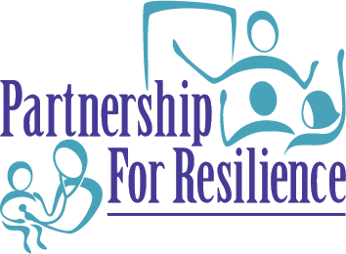
host a screening and discussion of Resilience

Slide 2
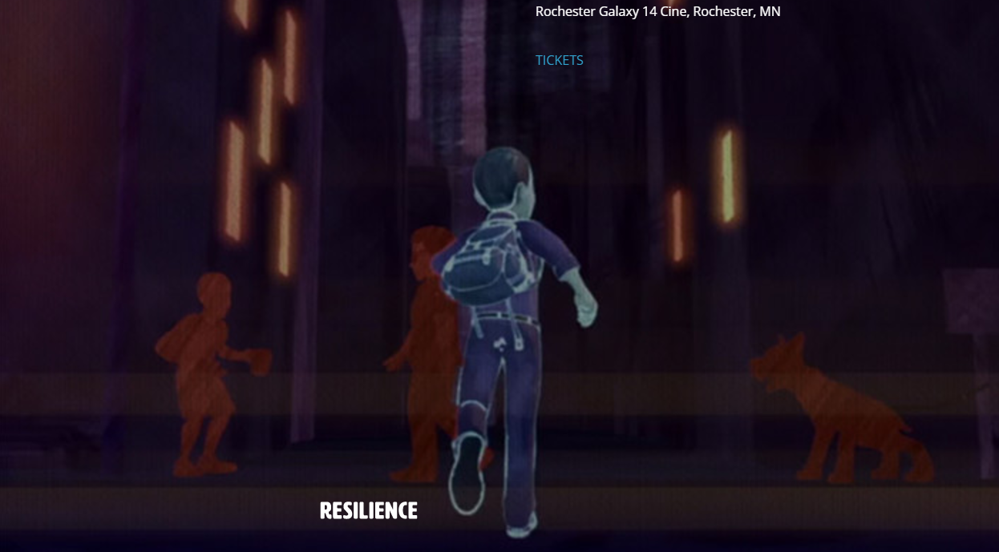

Slide 3
ICAAP mission: To promote the right of all children to live happy, safe, and healthy lives, to ensure children receive quality medical care from pediatricians (the most qualified physicians to deliver this care), and to assess and serve the needs of its membership. IEA mission: To effect excellence and equity in public education and to be the advocacy organization for all public education employees.

Slide 4
Panelists

Slide 5
Resilience is
the ability to thrive, adapt and cope despite stress,
a natural counter-weight to ACEs,
not an innate characteristic,
a skill that can be taught, learned and practiced.
The more resilient, the more likely able to deal with negative situations in a healthy way.
Everybody has the ability to become resilient when surrounded by the right environments and people.
Prevent Child Abuse America

Slide 6
AAP definition of toxic stress:
When a person experiences strong, frequent, or prolonged activation of the body’s stress response systems in the absence of the buffering protection of a supportive, adult relationship.

Slide 7
Cynthia Manfold, Kindergarten Teacher
“The sad thing is a lot of our students think that what they are going through is normal, this is their normal. If no one has given them anything to think otherwise, I think that is where the cycle just keeps going and going.”

Slide 8
Dr. Jack Shonkoff, Harvard University
“We need to do more than give parents information and advice: we need to build their capabilities.”
“Scientific research points to the presence of a stable, caring adult in a child’s life as the key to building the skills of resilience.”

Slide 9
“Exposure to early adversity and trauma literally affects the structure and function of children’s developing brains.”
Dr. Nadine Burke Harris, Center for Youth Wellness
“If all day long you feel like a truck is coming at you, day after day after day, that’s going to take a toll on the body.”
Dr. Victor Carrion, Stanford University

Slide 10
“If [people] already know that these [ACEs] are common, they are more likely to be relieved, I think, than frightened...they don’t feel alone anymore. That ‘I’m not the only one that experienced these kinds of things.’”
- Dr. Robert Anda, Centers for Disease Control and Prevention
Indicators of Family Dysfunction
6. Mentally ill, depressed or suicidal person in the home
7. Drug addicted or alcoholic family member
8. Witnessing domestic violence against the mother
9. Parental discord – indicated by divorce, separation, abandonment
10. Incarceration of any family member
Abuse and Neglect
Child physical abuse
Child sexual abuse
Child emotional abuse
Physical Neglect
Emotional Neglect

Slide 11
www.Partnership4Resilience.org
IEA Connect - 1-8444-432-1800
Email:

